Slide 1
World war 2
Presented by Millie W and Millie E

Slide 2
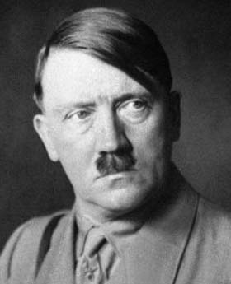
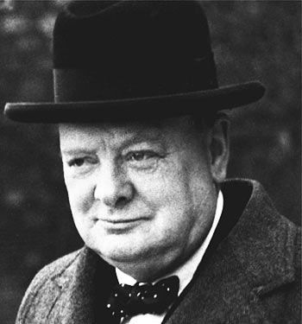
Adolf Hitler
Adolf Hitler was leader of the Germans.
He was born in 1889 20th April and died
On the 30th April 1945.
Winston
Churchill
Winston Churchill was leader of England.
He was born in 1874 30th November and
died on the 24th January.

Slide 3
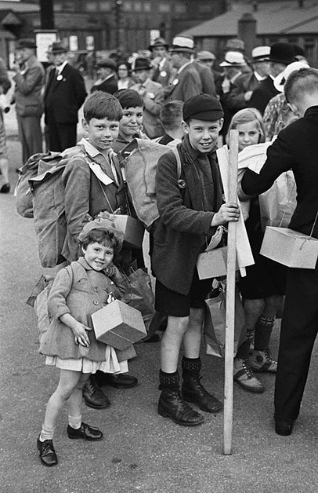
Evacuees
We can only begin to imagine what
It would be like for the evaqees. Evacuation
Was intrudused by the govement in 1933.

Slide 4
plans

