Slide 1
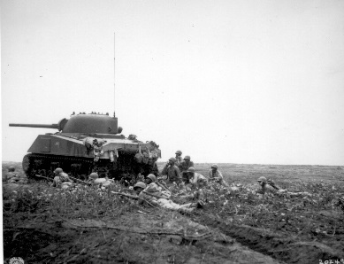
World war 2
By Fin and Josh

Slide 2
Spitfires
Spitfires were used in ww2 to wreck the Germans.
They were fighter planes
They were made out of aluminium
They were one of the smallest planes in wwII

Slide 3
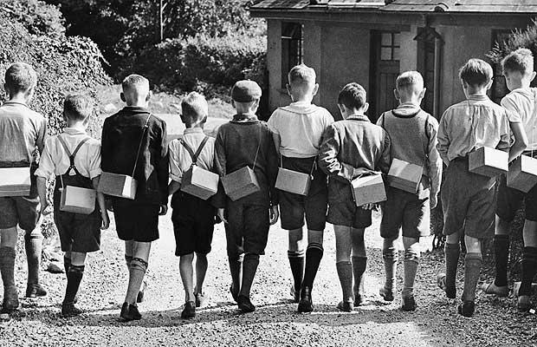
EVACUEES
Evacuees are children that since of the war have to be sent away so they didn’t get bombed

Slide 4
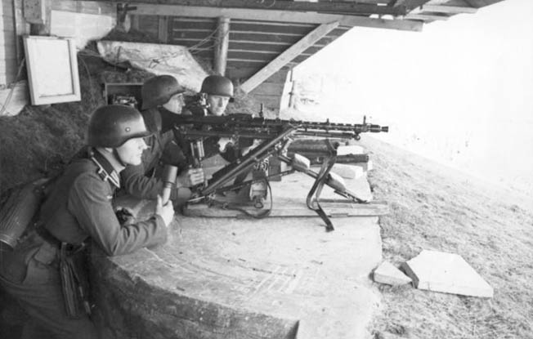
The "D" stands for Day. D-Day and H-Hour stand for the secret day/time an operation is scheduled to begin.
Code names for the five beaches where the Allies landed: Utah, Omaha, Gold, Juno, and Sword. The date June 5, 1944, was originally chosen for the invasion, but bad weather forced the Allies to postpone a day.

Slide 5
ADOLF HITLER
He was the German army leader and hated Jews. He took part in the Nazi party. He was a brutal man who made Jews wear a jewish star on there shirts. If found with a star on them they would be taken to a concentration camp and then finally get killed.

