Slide 1
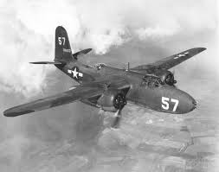
World War 2
By Emily and Lewis

Slide 2
Watch this short clip of good night mister tom
In September 1939, the United Kingdom entered the Second World War and children were evacuated from London to the countryside for their safety. Tom Oakley, a lonely and bitter old man living in the countryside village of Little Weirwold, is forced to look after one of the evacuees, William "Willie" Beech. Tom has long since withdrawn from life after losing his wife and child to scarlet fever many years ago, while Willie is a quiet young boy who comes from an abusive home and is apprehensive of Tom.

Slide 3
Good Nigh Mr Tom

Slide 4
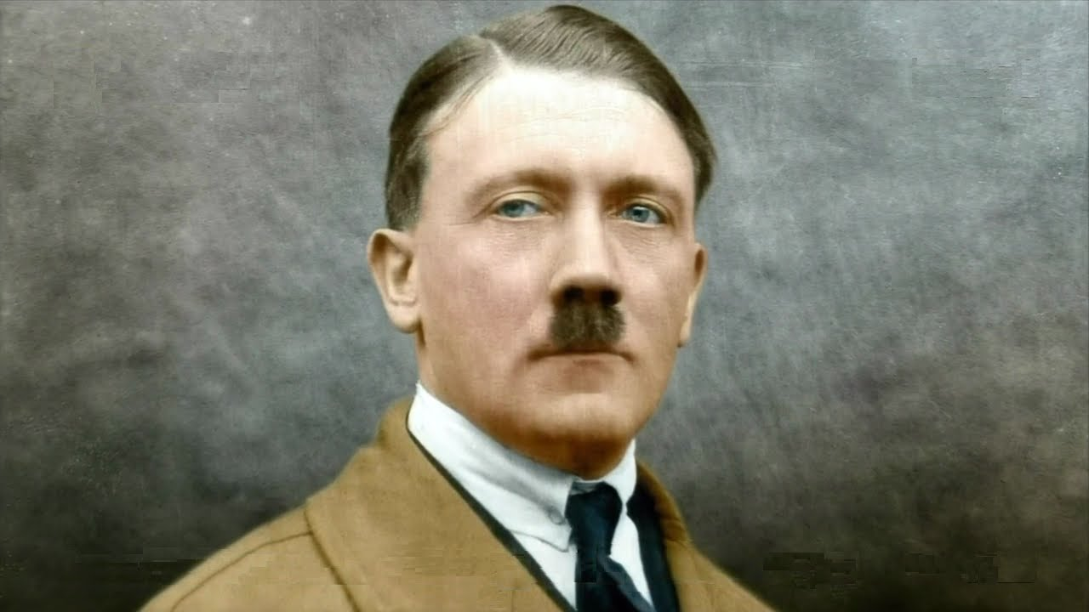
ADOLF HITLER
Hitler was a selfish man and he didn’t like Jews.
He declared war on Poland.
ethnicAdolf Hitler, one of the worst dictators ever if not the worst in recorded human history, was responsible for 60 to 85 million deaths during the WWII as he had triggered the conflict. His name brings connotations of murder, misery, warfare, holocaust and the attempted extermination of the Jews and other minorities. Hitler openly expressed his hatred of Jews in his book ‘Mein Kampf’. He warned everyone about his intention to drive the Jews and minorities from Germany’s cultural, intellectual and cultural life.
Before invading Poland and triggering the WWII, Hitler gave example of Genghis Khan to his generals. He said that though Genghis Khan happily led millions of women and children to slaughter with predetermination, history still considered him solely the founder of the Mongol state; not as a murderer.
As a result of the Holocaust engineered by Hitler and his Nazi regime, 6 million Jews or around 78% of the total Jewish population (around 7.3 million) in Nazi occupied Europe at that time and an additional 5 million non-Jewish people were killed. From 1941 to 1945, Jews and other racial, political and minorities in Europe were targeted and systematically murdered by the Nazi forces.

Slide 5
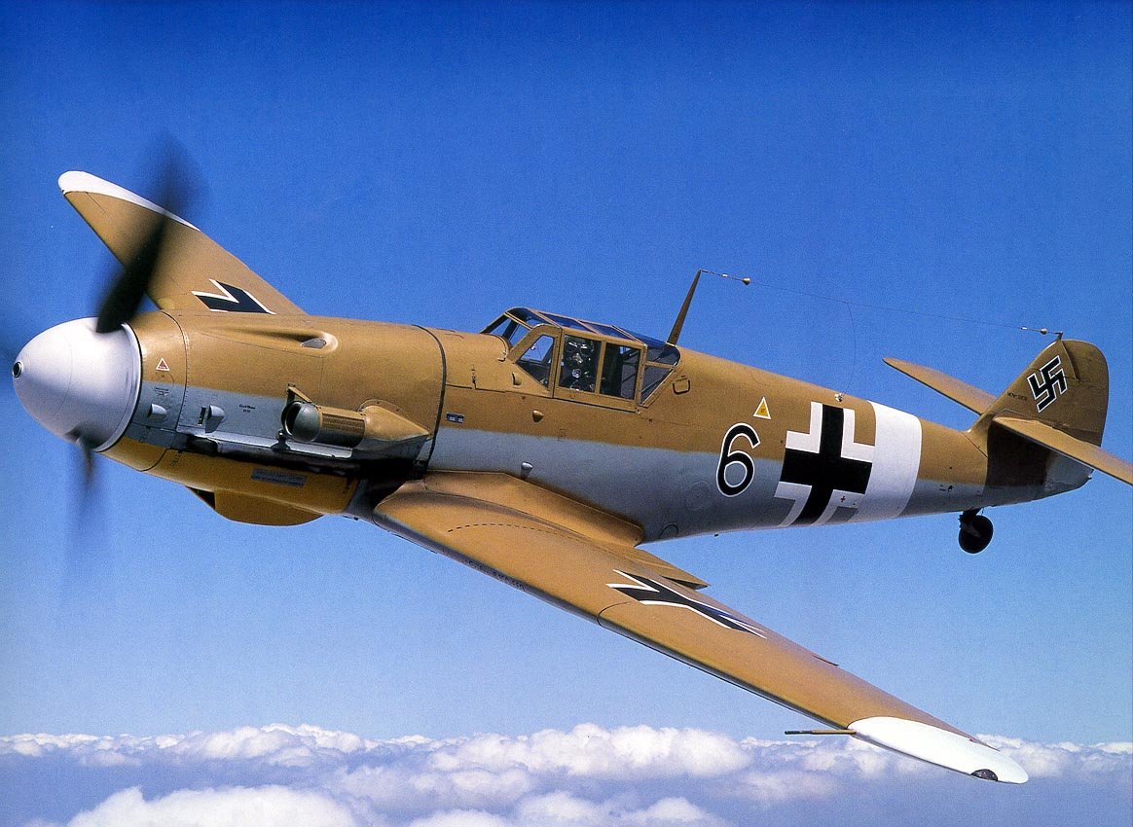
World War 2 Planes
Major Battles in the Air The first major attacks in World War II were made by German aircraft in the takeover of countries such as Denmark, Poland, and the Netherlands. Later, Germany would attempt to destroy England's Royal Air Force in the Battle of Britain. During this battle, German planes dropped thousands of bombs on England for over three months straight. The Allies later countered with a major air attack on D-Day during the Invasion of Normandy. They launched around 14,000 sorties (airplane attacks) in one day. There were also major air battles in the Pacific during World War II. The first major attack was when the Japanese bombed Pearl Harbor in 1941. Later, aircraft played major roles in the Battle of the Coral Sea, the Battle of Midway, and the Battle of Guadalcanal. The final blow in the war was also struck by aircraft when atomic bombs were dropped on the Japanese cities of Hiroshima and Nagasaki.

Slide 6
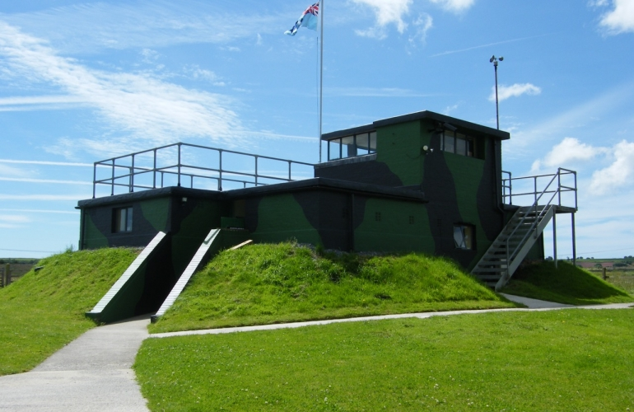
Carew Cheriton Control Tower & Air Field
Carew Airfield history
The air ministry took the first steps to acquire the 600 acres of land south of sageston and east of carew cheriton to build a new airfield in 1938.
In the summer there are activities that you can come to
You can see the control tower as well as seeing all the plains.

Slide 7
Underground

