Slide 1
FINSTALL FIRST SCHOOL PARENTS’ ASSOCIATION
Who / What Are We?
A great bunch of people!!!!!!!
Group of Parents who get together to raise funds for the school for items that will directly benefit all the children

Slide 2
FINSTALL FIRST SCHOOL PARENTS’ ASSOCIATION
How Do We Do This?
Annual Xmas Fayre
Annual Summer Fayre – 23 June 2018 @ 2.00PM – please come along as new parents
Quiz Nights
Summer Ball
Kids Film Nights
Xmas Card Sales
Local Business Donations

Slide 3
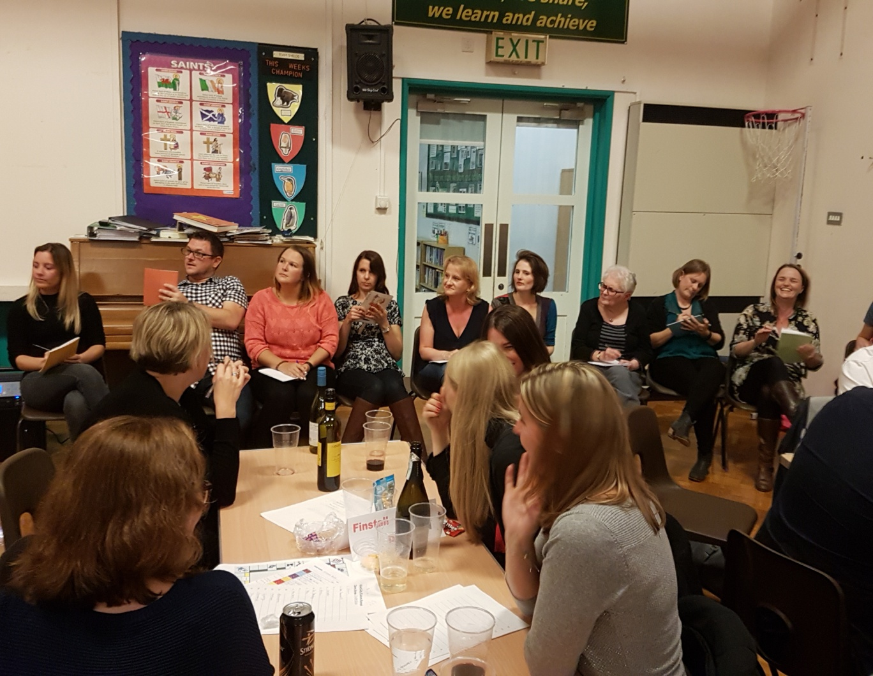

Slide 4
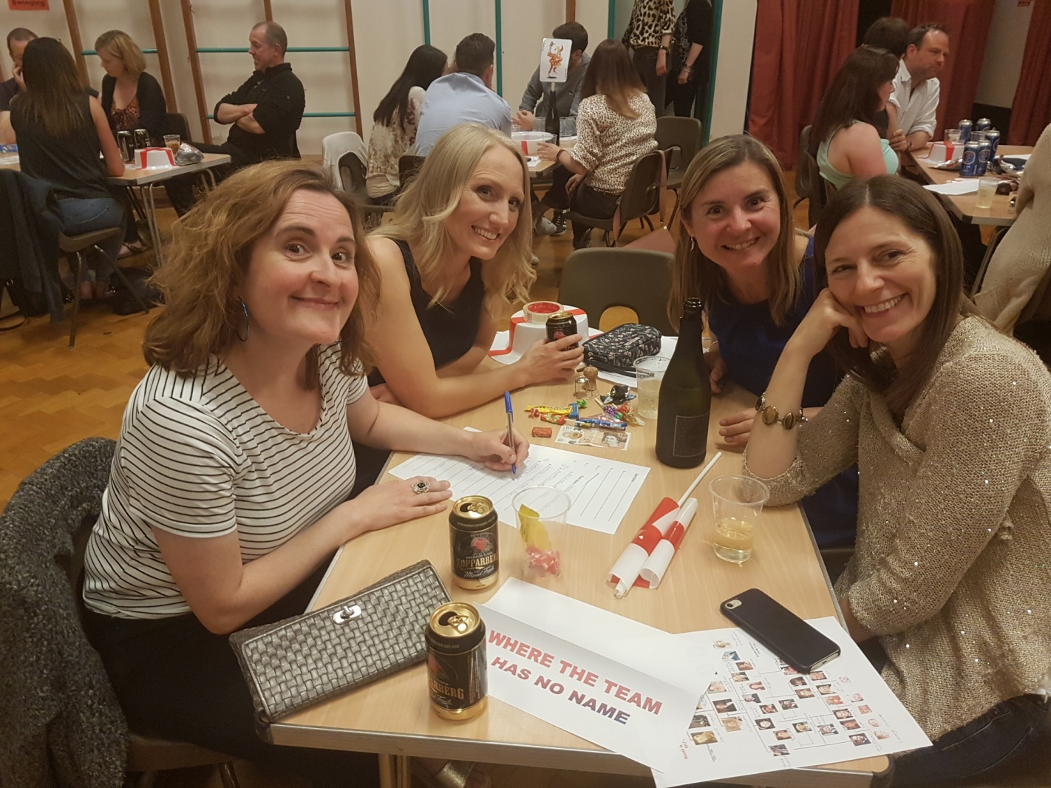
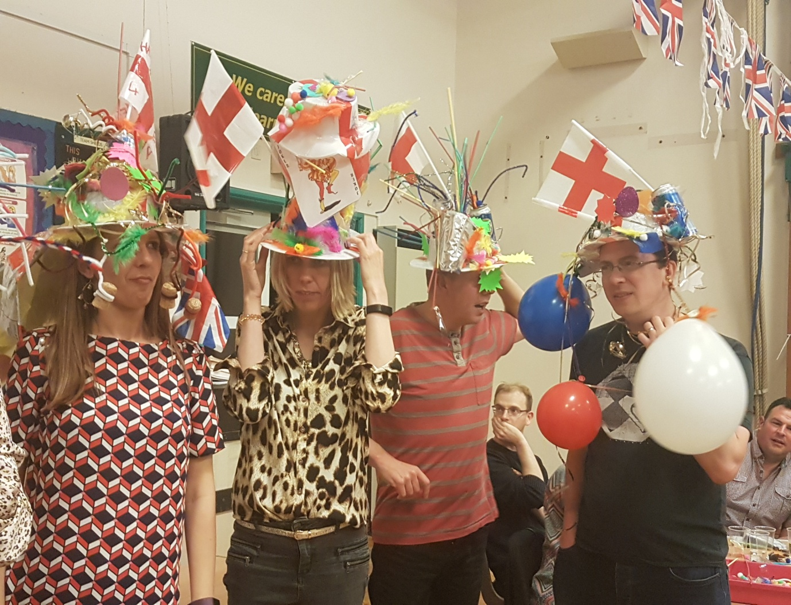

Slide 5
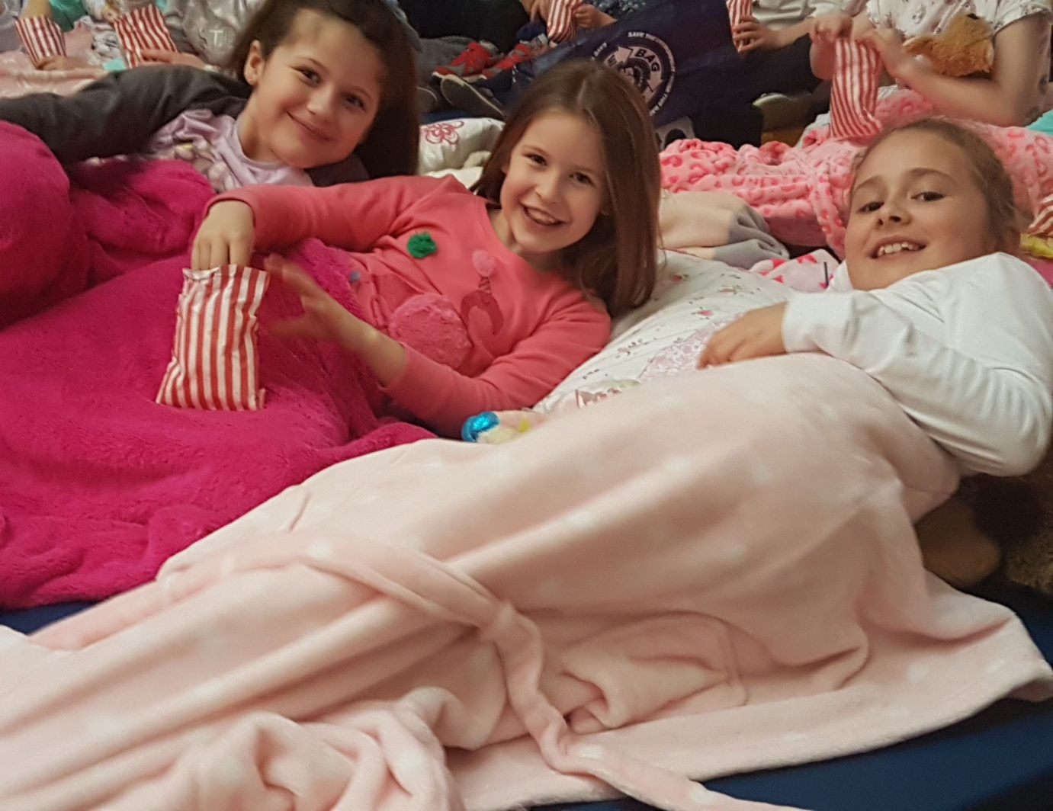
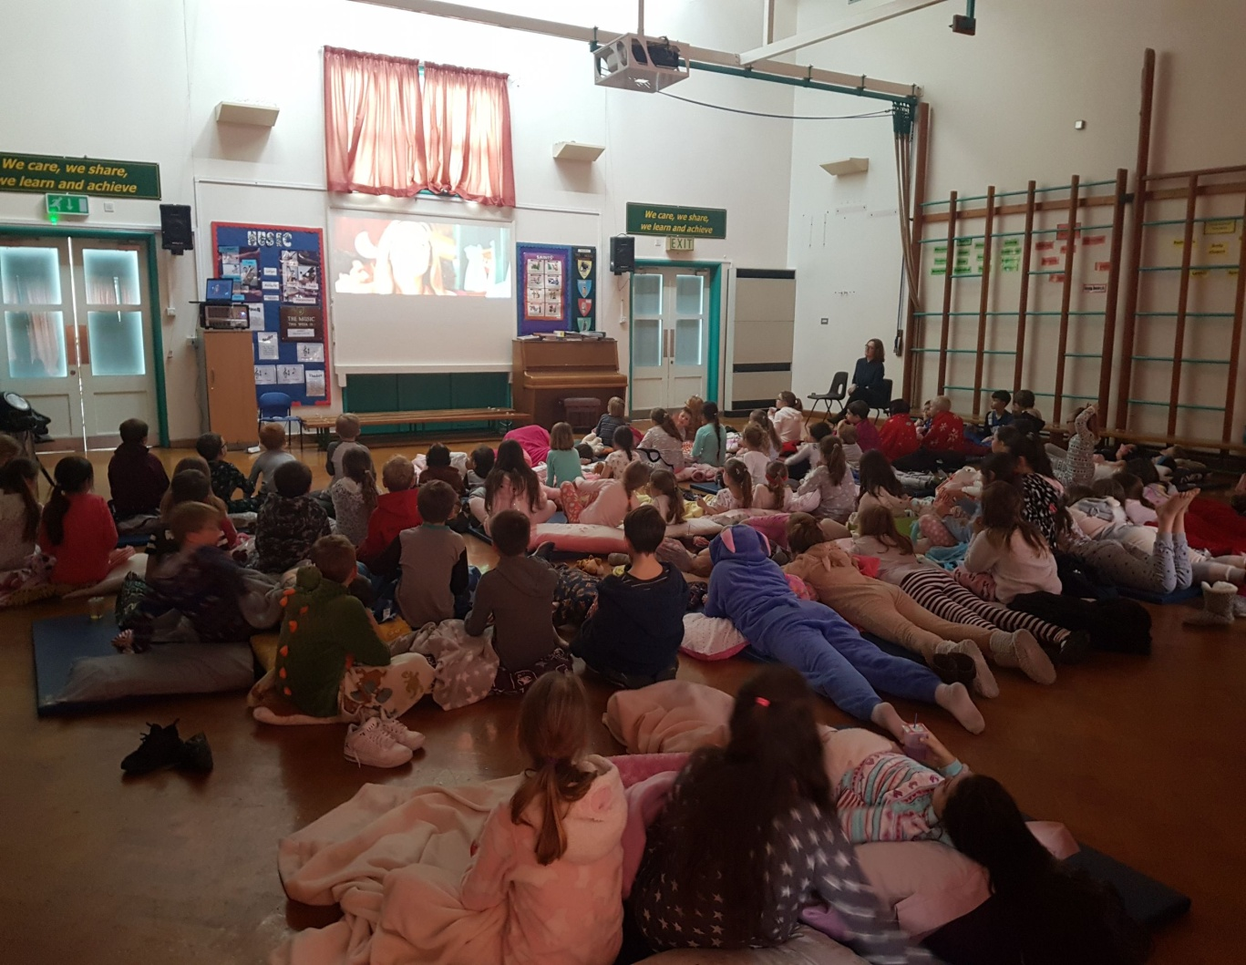

Slide 6
FINSTALL FIRST SCHOOL PARENTS ASSOCIATION
What Does This Fund?
In last 3 years we have made total donations of over £15,000 to the School.
This has funded:
25 IPads for use by the children
Outside play area
Re-marking of playground
Transport for Lower School Xmas Panto Theatre Trip
Leavers Party

Slide 7
FINSTALL FIRST SCHOOL PARENTS’ ASSOCIATION
What Do We Want From You as New Parents?
Support the Parents’ Association by:
A Willingness to give up a couple of hours prior to events – usually in the pub!!!!
Help out at events
Attend the events and meet fellow parents
Bring new / fresh ideas to the party
People to step into our roles – in two years we will be gone – it’s your association that will benefit your children

Slide 8
“YOUR P.A. NEEDS YOU

