Slide 1
World war 2
Presented by Sophie and Leah

Slide 2
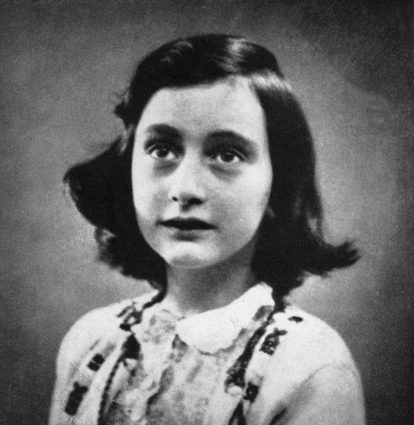
Important people in world war 2
Anne Frank
Anne Frank was a girl who lived in World War two.
She was a Jew but that is not good because Adolf Hitler hated Jews so he killed them.
She hid behind a book case so she almost survived but her dad surrvived.

Slide 3
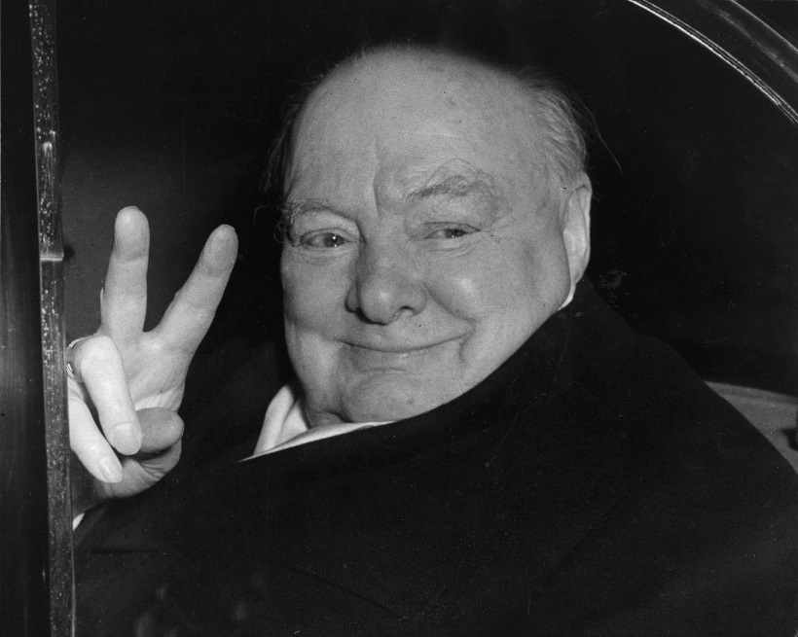
Winston Churchill
This is Winston he did this sign and it means victory.
Winston was the second prime minister in ww2 he was a good man but German people hated him.
CLICK HERE FOR A VIDIO

Slide 4
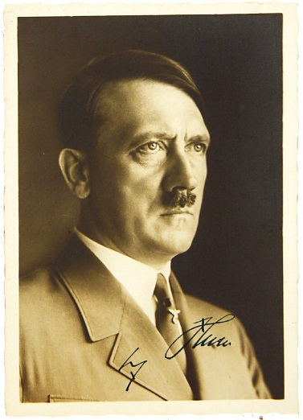
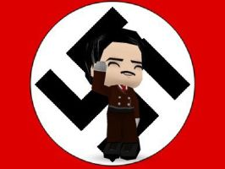
Adolf Hitler
HE STARTED THE WAR !!!
Adolf Hitler was the German leader he hated Jews and he wanted to take over contries.

Slide 5
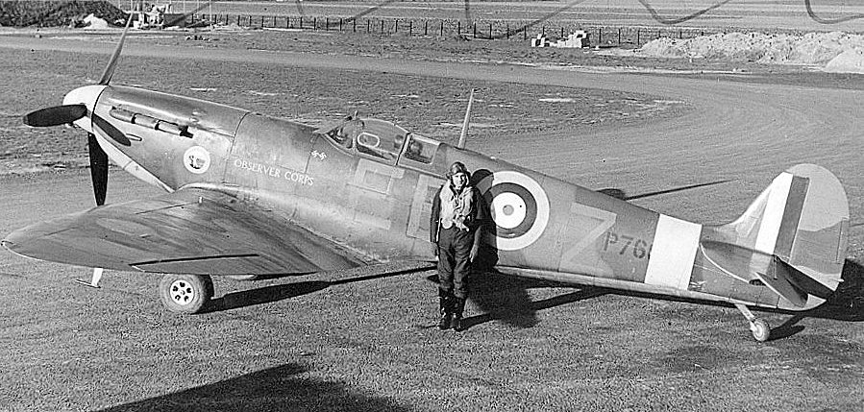
Spitfire
PLANES
The spitfire was the most famous plane in ww2.

