Slide 1
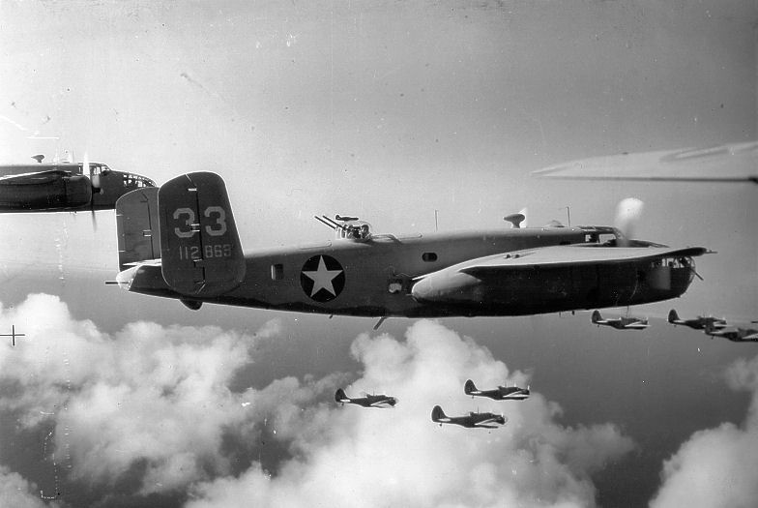
World War 2
Presented By Will And Jack

Slide 2
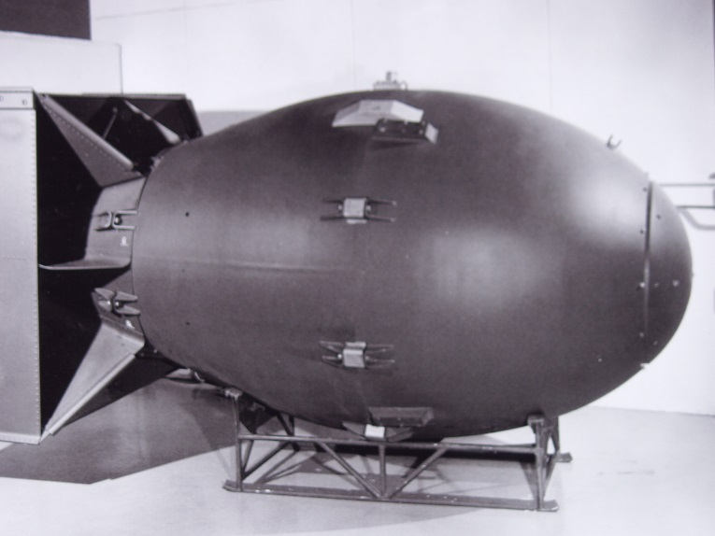
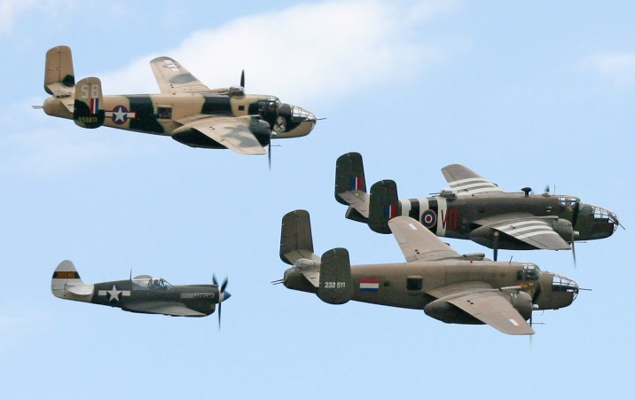
The Bombers In World War 2
The bombers fly around bombing the enemies.
They usually bombed the big cities if they knew they were there.
The planes have the badges of there country.
The bombers would bomb anything that they saw. If they saw something they would instantly bomb it even if they saw one light.

Slide 3
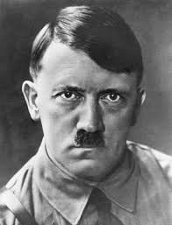
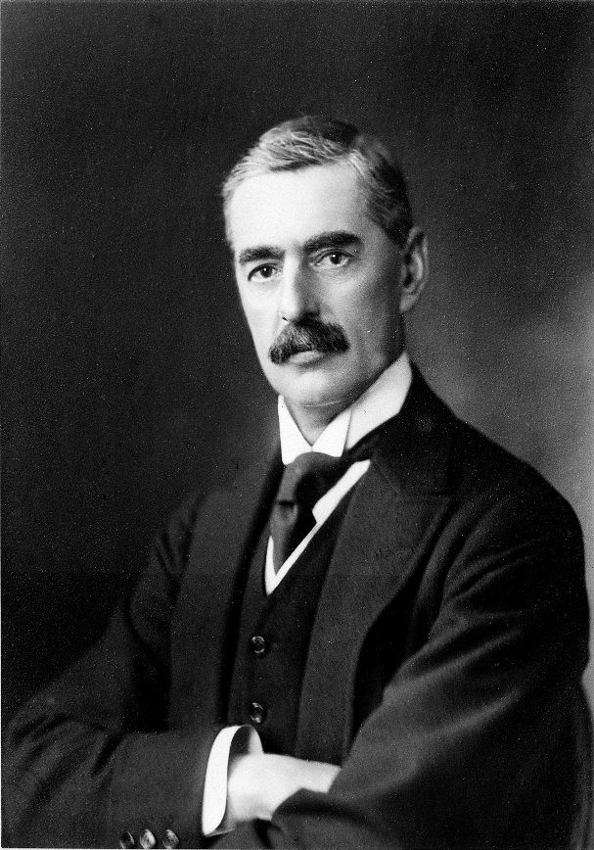
World War 2 Leaders
Adolf Hitler
Hitler was the leader of the Germans. He didn’t like the Jewish people so he put a star on them. Hitler wanted the whole world to belong to Germany. He committed suicide because he knew the British people were coming for him.
Neville Chamberlain
Click image to see Neville Chamberlain’s Speech >>
Neville Chamberlain was the British President. He was the person that declared war on Germany. Germany didn’t listen and they started the Second World War.

Slide 4
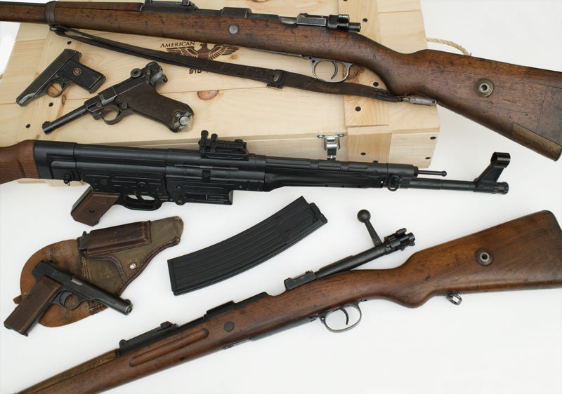
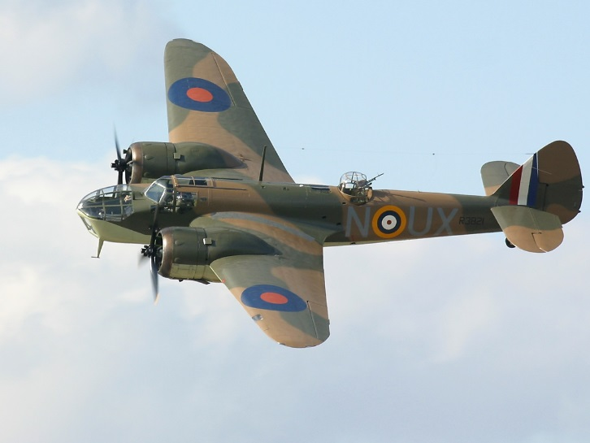
World War Two Weaponry and Artillery
The Germans and British had a colossal amount of weapons that included guns, planes and tanks! There were a lot of planes and some of them were:
Spitfire
Hurricane
Henkel
Messerschmitt
List of the WW2 Weaponry:
Bayonet
Pistols
Shotgun
Machine gun.

