Slide 1
Welcome to Finstall
From Finstall First School Parents’ Association (the PA)
Notes:
Hi and welcome, my name’s Ruth Turner and I’m the chairperson of FFSPA. Hi to all the returning parents and a big hello and welcome to everyone who’s new to the school and has probably never set foot in here before!

Slide 2
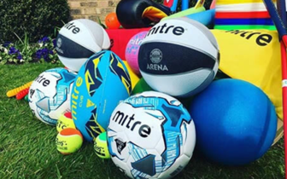
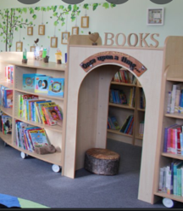
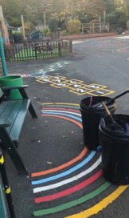
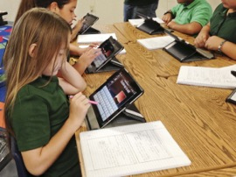
So what’s the PA, then?
Finstall First School Parents’ Association (the PA)
A registered charity that is separate to the school but set up to support the school with fundraising activities
Raise money for projects the school budget doesn’t cover
PA committee of five of us
Ruth Turner, Chairperson
Holly Gray, Treasurer
Sarah-Louise Collier, Vice-Chair
Suzanne Anderson, Secretary
Louise Forrest, Senior Fundraiser
Plus a fantastic team of volunteers!
Notes:
Although not part of the school we work closely together to raise money for things that directly benefit our children. In the past, we’ve funded playground equipment, reading books and school trips. Governed by the charity commission.
This year we’re raising money for a refurbishment of the new school library; in previous years it’s been playground markings, sports equipment, ipads and reading books.
Volunteers help out as much or as little as they want with no strings attached. Flexible. Mainly needed for events.

Slide 3
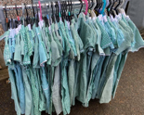
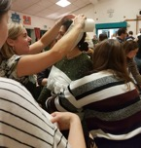
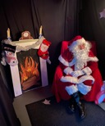
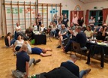
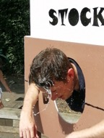
What does the PA do?
We use a variety of ways to raise money!
Events: Christmas Fayre, Summer Fete, Quiz Nights, After-School parties, Uniform sales
Activities: Competitions, Sponsored Read, Trails, Dress-Up Days, Christmas Cards, Merchandise projects
Other revenue streams: Easyfundraising, Gift Aid
Instill a sense of community
…and lots more!

Slide 4
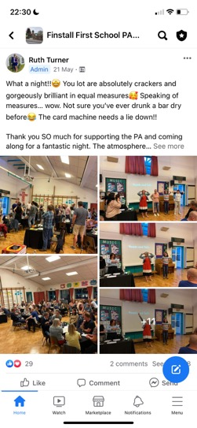
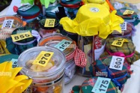
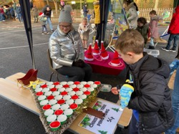
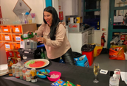
How you can help the PA
Volunteer to help at events
Supply events and activities with donations (prizes, sponsorship etc.)
Engage and communicate!
Support by giving some of your hard-earned cash to a great cause
Notes:
We always need helpers at our two main events – summer fete and Christmas fayre plus after school discos
Shout outs for prizes for the tombola, raffle, cakes, teddies
We’d really appreciate you liking and sharing our posts on the FB page and also

Slide 5
Coming up…
Friday 7 July,
9.10 – 10.30am
A welcome party for all new starters
Toys, activities, craft, snacks and the chance to meet your new classmates!
Notes:
Forms available in your book bags

Slide 6
Coming up…
Friday 7 July, 7.30pm
Quiz night for the parents in the school hall
Trivia, crazy rounds, licensed bar, hot food and snacks
Come and join us!!

Slide 7
Thank you!
We look forward to seeing you all again!
Notes:
Forms available in the foyer and they’ll also be emailed to you PRINT FORMS

